Slide 1
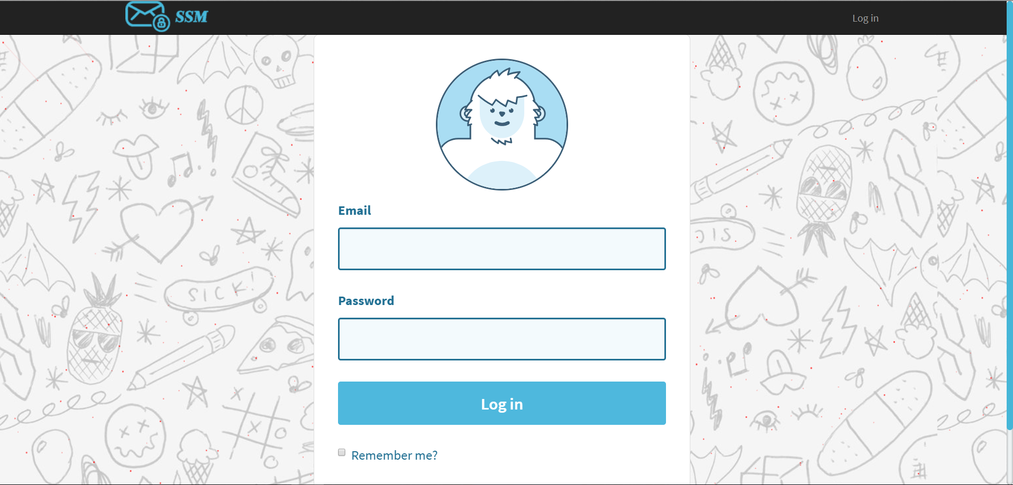
SSM – Send Secure Message
www.ssmessage.com

Slide 2

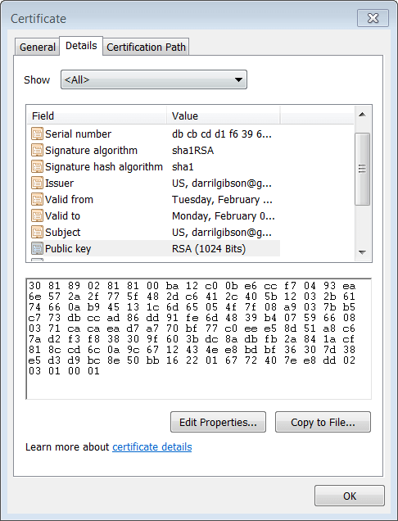
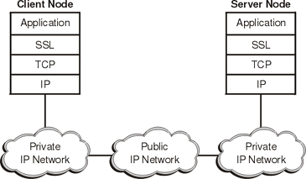
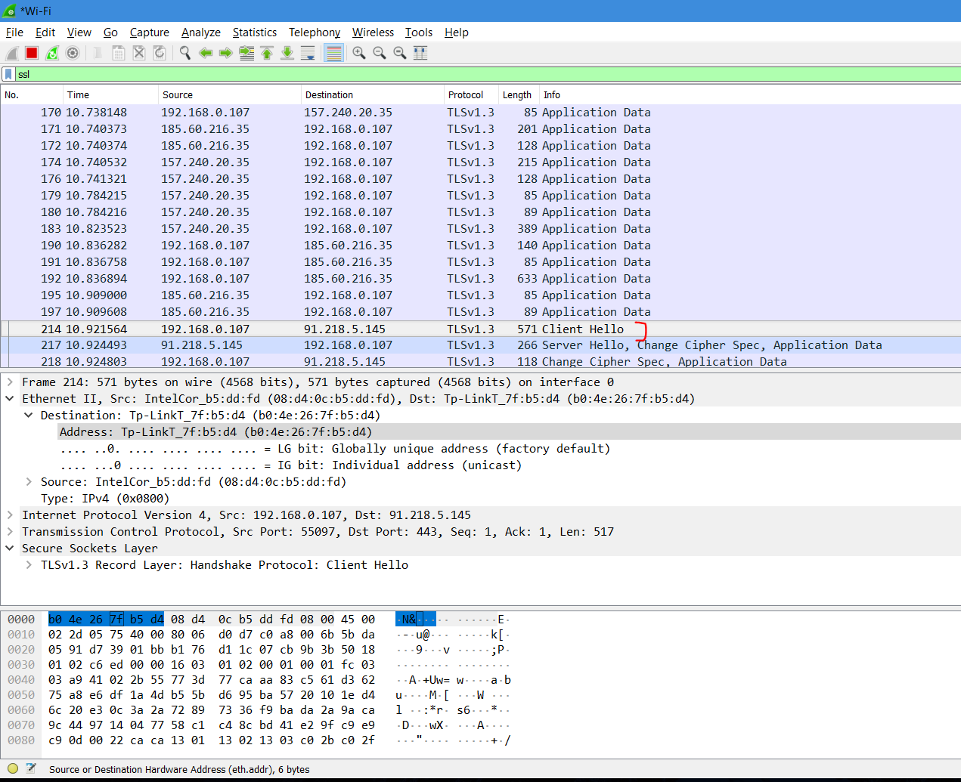
SSL - Secure Sockets Layer
TCP/IP Model

Slide 3
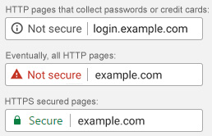
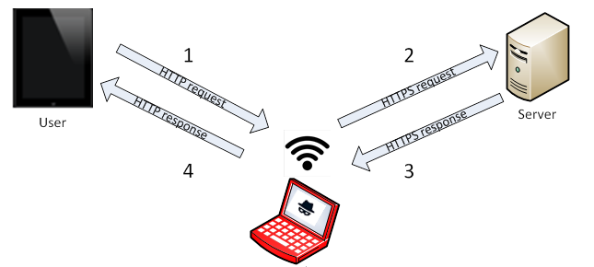
SSLstrip Attack

Slide 4
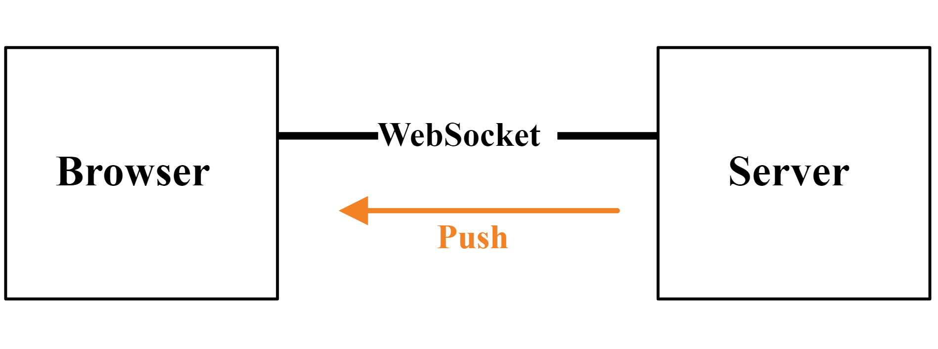
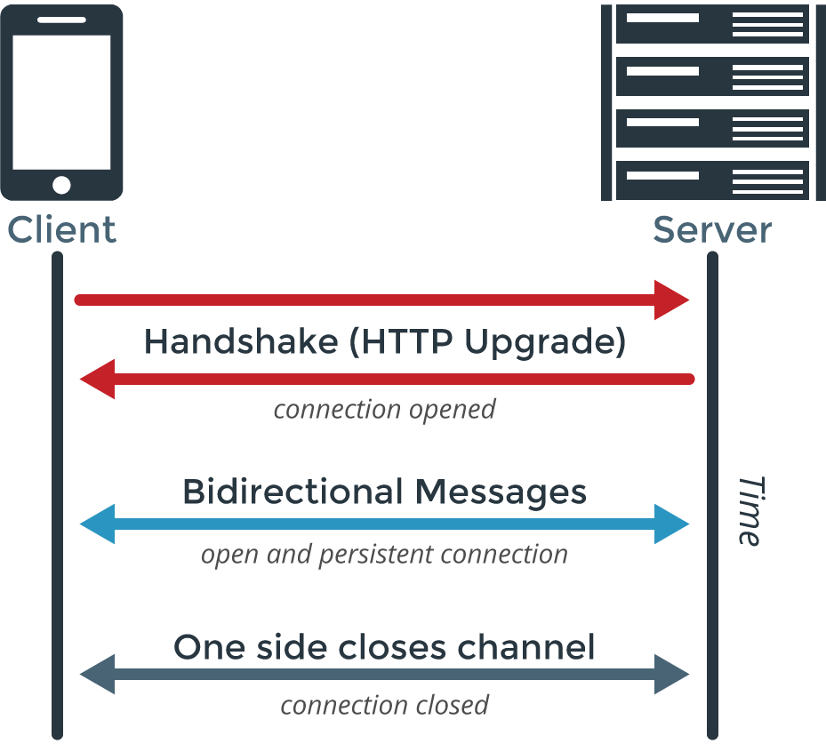
WebSocket

Slide 5




RSA & AES
User 1
User 2
RSA Public Key
AES Symmetric Key

